Slide 1
Beyond Traineeships – What Next Integrating Traineeships into the Study Programme and AEB Youth Employment UK Webinar 21 June 2023

Slide 2
Traineeships from 1 September 2020 to 31 July 2023
A flexible education and training programme for 16–24 year olds (up to age 25 with EHCP), lasting between 6 weeks and 12 months.
Traineeship core elements:
High quality work placement lasting 70-240 hours with an employer.
Work preparation training with training provider
English and maths, if qualified below level 2, and digital training with a training provider.
Optional sector focussed technical and professional qualifications to help learners prepare for occupational standards within apprenticeships
There will be continued flexible delivery of all of these elements so that providers and employers can deliver programmes based on learner need and the local labour market
Notes:
Toni to present

Slide 3
Traineeships from 1 August 2023
Integrated back into the Study Programme and Adult Education Budget
£40m back into the Study Programme
£8.55m back into the AEB (£7.55m to directly fund traineeship type provision and £1m to cover carry over costs for the standalone programme)
Funding for traineeship type provision devolved to the Mayoral Combined Authorities from 1 August 2023
No significant changes to the Study Programme funding rules
Work Experience added to the AEB as a learning aim and funded (covered in the current non-devolved AEB procurement)
Awarding a small number of new Study Programme contracts to circa. 30 ITPs in 21 Local Authorities that have said the decision to integrate traineeships will create a gap in 16-18 provision from 1 August 2023

Slide 4
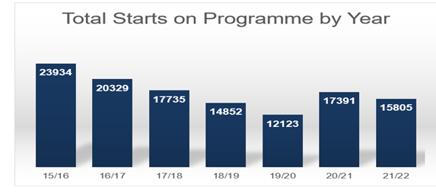
Case for Integration

Slide 5
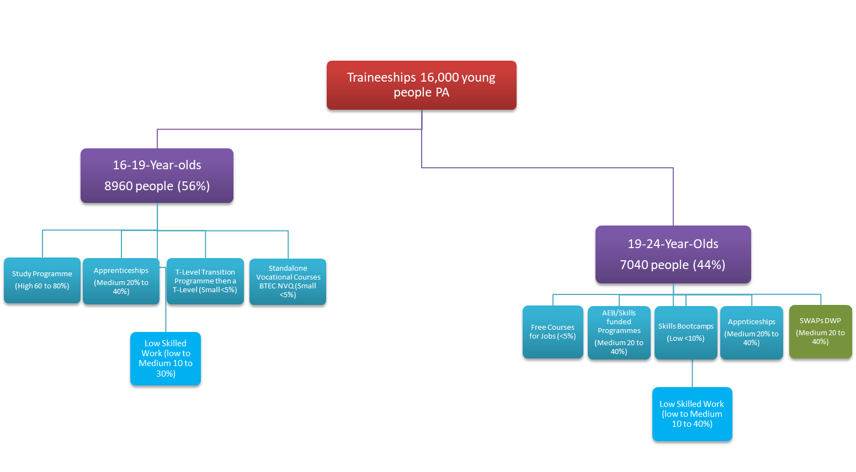
Meeting the Needs of the Traineeship Cohort

Slide 6
Key Messaging to employers, providers and young people
Traineeships have not ended, they have been integrated into the Study Programme and AEB
Any provider with access to Study Programme Funding and AEB funding can offer all of the elements of a traineeship (work preparation, functional skills, occupational learning and qualifications and work experience)
We are working with providers to ensure that traineeship type opportunities are sign-posted to young people
Providers may not call them traineeships (i.e. West Midlands Combined Authority are creating a pre-apprenticeship programme and calling it a ‘Pathway to Employment’, aligned to jobs and apprenticeships in the local labour market and in areas of high levels of unemployment amongst young people)

Slide 7
Key Messaging to employers
Traineeship type provision:
Can form the beginning of an organisation’s talent pipeline giving current employees experience in training and mentoring
Allows employers to design a programme that suits both the needs of your business and the needs of the trainee
Can help employers increase capacity and productivity
Can help employers develop a loyal and talented workforce
Allows employers to help tackle youth unemployment
Is a route into an apprenticeship
Allows employers to get to know and work with young people prior to recruiting apprentices

Slide 8
Questions / open discussion

